Slide 1
Business Intelligence Concepts, Tools, and Applications
Week 1: Decision Making and Decision Support Systems
Lesson 1: Overview of Decision Making

Slide 2
Overview of Decision Making
Learning Objectives
Identify role of computerized support for decision making and explain its importance
List the different types of decisions managers face, and the process through which they make a decision.

Slide 3
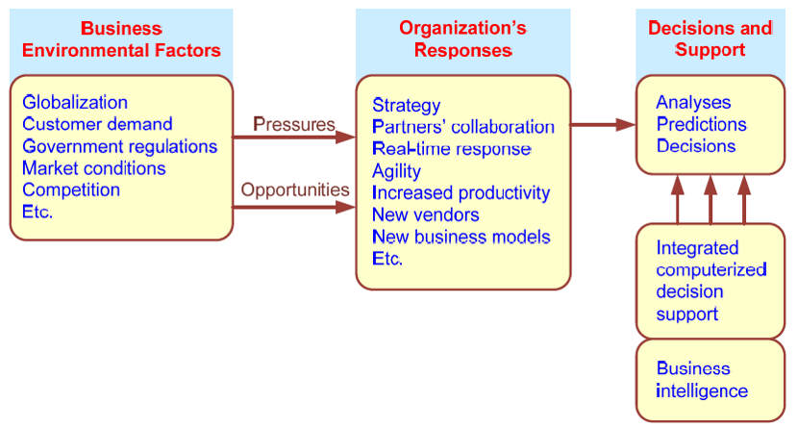
Business Pressures–Responses–Support Model
From SHARDA, RAMESH; DELEN, DURSUN; TURBAN, EFRAIM, BUSINESS INTELLIGENCE AND ANALYTICS: SYSTEMS FOR DECISION SUPPORT, 10th Edition, © 2015. Used by permission of Pearson Education, Inc., New York, NY. All Rights Reserved.
Notes:
From SHARDA, RAMESH; DELEN, DURSUN; TURBAN, EFRAIM, BUSINESS INTELLIGENCE AND ANALYTICS: SYSTEMS FOR DECISION SUPPORT, 10th Edition, © 2015. Used by permission of Pearson Education, Inc., New York, NY. All Rights Reserved.

Slide 4
Decision Making
Is a process of
choosing among two or more alternative courses of action for the purpose of attaining one or more goals.
It is influenced by
behavioral and scientific disciplines.
Notes:
Behavioral disciplines include anthropology, law, philosophy, political science, psychology, social psychology, and sociology.
Scientific disciplines include computer science, decision analysis, economics, engineering, the hard sciences (e.g., biology, chemistry, physics), management science/operations research, mathematics, and statistics.
Managerial decision making is synonymous with the entire management process
In making a decision, a manager (1) draws on existing knowledge to find out what is (the current state)?, (2) Creates new knowledge for what to do with resources, and what will be the future state (desired or expected)?

Slide 5
Managerial Roles
Interpersonal roles
Figurehead
Leader
Liaison
Informational roles
Monitor
Disseminator
Spokesman
Decisional roles
Entrepreneur
Disturbance handler
Resource locator
Negotiator
Sources: (1) Compiled from H. A. Mintzberg, The Nature of Managerial Work. Prentice Hall, Englewood Cliffs,
NJ, 1980; and (2) H. A. Mintzberg, The Rise and Fall of Strategic Planning. The Free Press, New York, 1993.
Notes:
Sources: (1) Compiled from H. A. Mintzberg, The Nature of Managerial Work. Prentice Hall, Englewood Cliffs,
NJ, 1980; and (2) H. A. Mintzberg, The Rise and Fall of Strategic Planning. The Free Press, New York, 1993.

Slide 6
Managerial Responsibilities
Planning
Organizing
Commanding
Controlling
Coordinating
From SHARDA, RAMESH; DELEN, DURSUN; TURBAN, EFRAIM, BUSINESS INTELLIGENCE AND ANALYTICS: SYSTEMS FOR DECISION SUPPORT, 10th Edition, © 2015. Used by permission of Pearson Education, Inc., New York, NY. All Rights Reserved.

Slide 7
Decision Making Steps
Define the problem
Construct a model
Identify & Evaluate possible solutions
Compare, choose, and recommend a potential solution to the problem
Notes:
From SHARDA, RAMESH; DELEN, DURSUN; TURBAN, EFRAIM, BUSINESS INTELLIGENCE AND ANALYTICS: SYSTEMS FOR DECISION SUPPORT, 10th Edition, © 2015. Used by permission of Pearson Education, Inc., New York, NY. All Rights Reserved.

Slide 8
Decisions Making Scenarios
Structured Decisions
established situation, programmable decision, situation fully understood, routine, specialized mfg. process
Unstructured Decisions
emergent situation, creative decision, situation unclear, one-shot, general processes
Semi-structured decisions
have some structured elements and some unstructured elements
From SHARDA, RAMESH; DELEN, DURSUN; TURBAN, EFRAIM, BUSINESS INTELLIGENCE AND ANALYTICS: SYSTEMS FOR DECISION SUPPORT, 10th Edition, © 2015. Used by permission of Pearson Education, Inc., New York, NY. All Rights Reserved.
Notes:
Source: Sharda, R. Delen, D. and Turban, E. (2015), Business Intelligence and Analytics: Systems for Decision Support, 10 ED.

Slide 9
Decision Making Constraints & Complexities
Evaluating what-if scenarios
Experimentation with a real system
Changes in the decision-making environment may occur continuously
Time pressure on the decision maker
Analyzing a problem takes time/money
Insufficient or too much information
Accuracy versus speed
Effectiveness versus efficiency
From SHARDA, RAMESH; DELEN, DURSUN; TURBAN, EFRAIM, BUSINESS INTELLIGENCE AND ANALYTICS: SYSTEMS FOR DECISION SUPPORT, 10th Edition, © 2015. Used by permission of Pearson Education, Inc., New York, NY. All Rights Reserved.
Notes:
From SHARDA, RAMESH; DELEN, DURSUN; TURBAN, EFRAIM, BUSINESS INTELLIGENCE AND ANALYTICS: SYSTEMS FOR DECISION SUPPORT, 10th Edition, © 2015. Used by permission of Pearson Education, Inc., New York, NY. All Rights Reserved.

Slide 10
Decision Making Support
Group communication and collaboration
Improved data management
Giant data warehouses and big data
Analytical support
Overcoming cognitive limits in information processing and storage
Knowledge management
The ability to access information anywhere, anytime
From SHARDA, RAMESH; DELEN, DURSUN; TURBAN, EFRAIM, BUSINESS INTELLIGENCE AND ANALYTICS: SYSTEMS FOR DECISION SUPPORT, 10th Edition, © 2015. Used by permission of Pearson Education, Inc., New York, NY. All Rights Reserved.
Notes:
From SHARDA, RAMESH; DELEN, DURSUN; TURBAN, EFRAIM, BUSINESS INTELLIGENCE AND ANALYTICS: SYSTEMS FOR DECISION SUPPORT, 10th Edition, © 2015. Used by permission of Pearson Education, Inc., New York, NY. All Rights Reserved.
We are discussing systems that support people who make decisions, not systems that make decisions on their own. Computers have historically supported structured and some semi-structured decisions, especially those that involve operational and managerial control, since the 1960s. Operational and managerial control decisions are made in all functional areas, especially in finance and production (i.e., operations) management.
In the next lesson we study the conceptual foundation of decision making and classification of decision making tasks. We will discuss the decision making styles and phases of decision making . People who make business decisions are often high enough in the organization to have choices as to how they make their decisions, so it is important to support decision-making methods and styles that they are willing to use. Understanding the phases of decision making is important in developing automated support, as the kind of support needed depends on the decision phase. This leads us to be introduced to decision support systems. We will then study an overview of technologies that have been broadly referred to as business intelligence.

